Slide 1
Obesity Management in Primary Care
Arya M Sharma, MD, PhD, DSc. (h.c.) FRCP(C)
Professor of Medicine
Research Chair for Obesity Research & Management
University of Alberta Medical Director Alberta Obesity Prevention & Bariatric Care Strategy
Edmonton, AB, Canada
www.drsharma.ca

Slide 2
Disclosures
Research Support:
Heart and Stroke Foundation of Canada, Canadian Diabetes Association, Networks of Centres of Excellence, Canada Research Chair, University Hospital Foundation and Canadian Institutes of Health Research.
I have also received research support, consulting and/or speaking honoraria from
Abbott, Allergan, Amylin, Astra-Zeneca, Arena, Boehringer-Ingelheim, Bristol-Myer Squibb, Covidien, GSK, Johnson and Johnson, Merck, Neurosearch, Novartis, Novo-Nordisk, Sanofi-Aventis, Takeda, Pfizer, Roche.

Slide 3
Obesity in Canada
1985
2010
30%
60%
Overweight
6%
20%
Obese
1%
Severely Obese
6%
Statistics Canada 2010

Slide 4
Obesity is a heterogeneous complex disorder of multiple etiologies characterized by excess body fat that threatens or affects socioeconomic, mental or physical health Sharma 2007

Slide 5
The 5 As of Obesity Management
Ask
Assess
Advise
Agree
Assist

Slide 6
Ask
Ask for permission to talk about weight

Slide 7
Ask Permission
Weight is a sensitive issue.
Many patients are embarrassed or fear blame and stigma.
Weight measurements and discussions of weight should be conducted in a private area.
Most patients prefer the terms ‘weight’, ‘size’ over ‘heavy’ or ‘fat’.

Slide 8
Ask
Ask for permission to talk about weight
Be non-judgmental

Slide 9
Be Non-Judgmental
Do no blame, threaten or provoke guilt in your patient.
Do not make assumptions about their lifestyles or motivation (your patient may already be on a diet or have lost weight).
Acknowledge that weight management is difficult and hard to sustain

Slide 10
Ask
Ask for permission to talk about weight
Be non-judgmental
Explore Readiness for Change

Slide 11
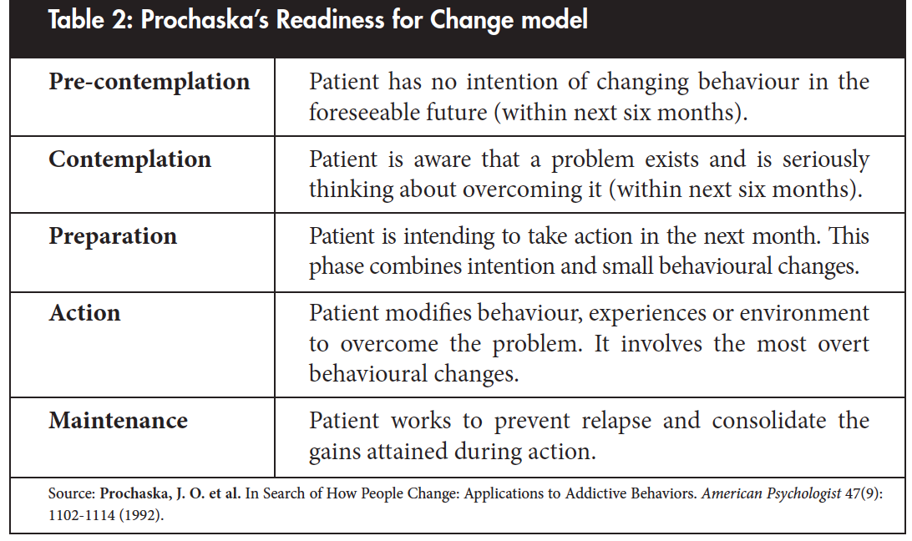
Readiness for Change

Slide 12
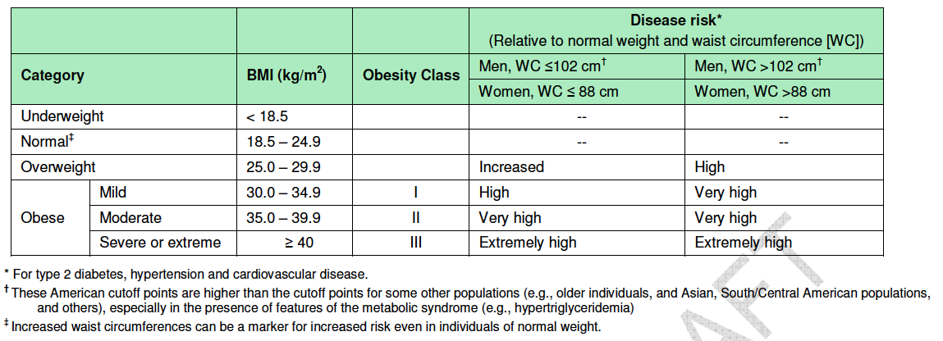
Assess
BMI and Waist Circumference

Slide 13
Relationship Between BMI and Percent Body Fat in Men and Women
Body Fat (%)
0
10
20
30
40
50
60
Body Mass Index (kg/m²)
Adapted from: Gallagher et al. Am J Clin Nutr 2000;72:694.
Notes:
Relationship between BMI and percent body fat in men and women
Body mass index (BMI) represents the relationship between weight and height. It is calculated as weight (in kilograms) divided by height (in meters squared). As shown in this figure, which contains data from 613 men and 876 women, BMI correlates with percent body fat mass in a curvilinear fashion in both men and women [1,2]. The relationship between BMI and percent body fat is sex and age dependent; at an equivalent BMI, women and older persons have a higher percent body fat than men and younger persons. In addition, persons who have a large muscle mass can have an “obese” BMI despite having a normal amount of body fat, while those with excess adiposity and reduced muscle mass can have a “normal” BMI.
Gallagher D, Visser M, Sepulveda D, et al. How useful is body mass index for comparison of body fatness across age, sex, and ethnic groups? Am J Epidemiol 1996;143:228-239.
Gallagher D, Heymsfield SB, Heo M, et al. Healthy percentage body fat ranges: an approach for developing guidelines based on body mass index. Am J Clin Nutr 2000;72:694-701.

Slide 14
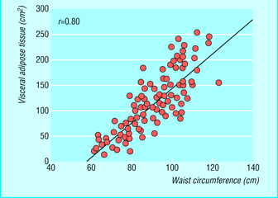
Relationship Between Visceral adipose Tissue and Waist Circumference
Pouliot MC et al.; Am J Cardiol 1994;73:460

Slide 15
Assess
BMI and Waist Circumference
Obesity Stage (EOSS)

Slide 16
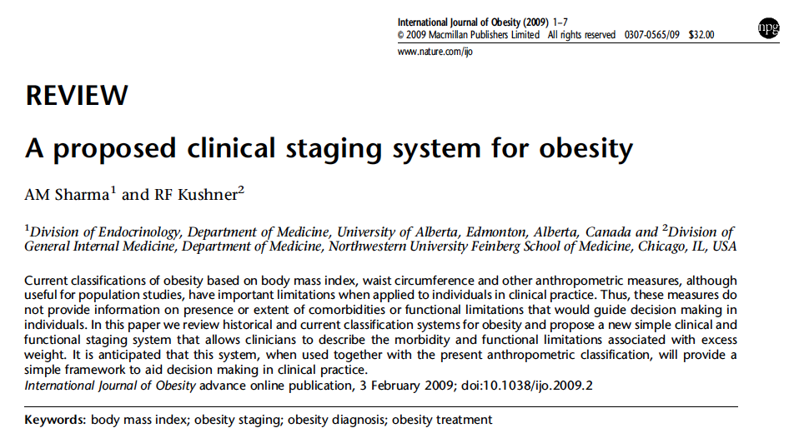

Slide 17
Edmonton Obesity Staging System (EOSS)
Stage 2
co-morbidity
Stage 1
moderate
Stage 3
pre-clinical risk factors
end-organ damage
moderate
mild
severe
mild
severe
Stage 0
Obesity
Stage 4
absent
absent
end-stage
absent
end-stage
end-stage
Medical
Mental
Functional
Sharma AM & Kushner RF, Int J Obes 2009

Slide 18
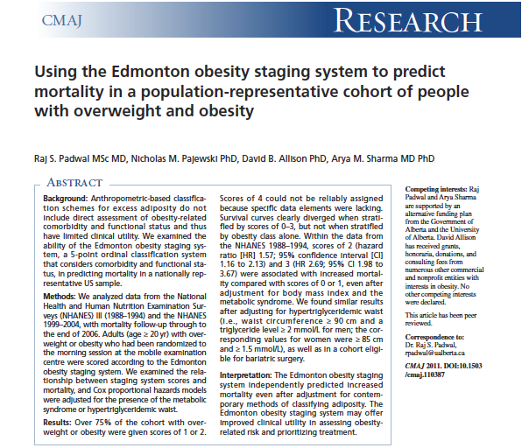

Slide 19
EOSS Predicts Mortality in NHANES III
Padwal R, Sharma AM et al. CMAJ 2011

Slide 20
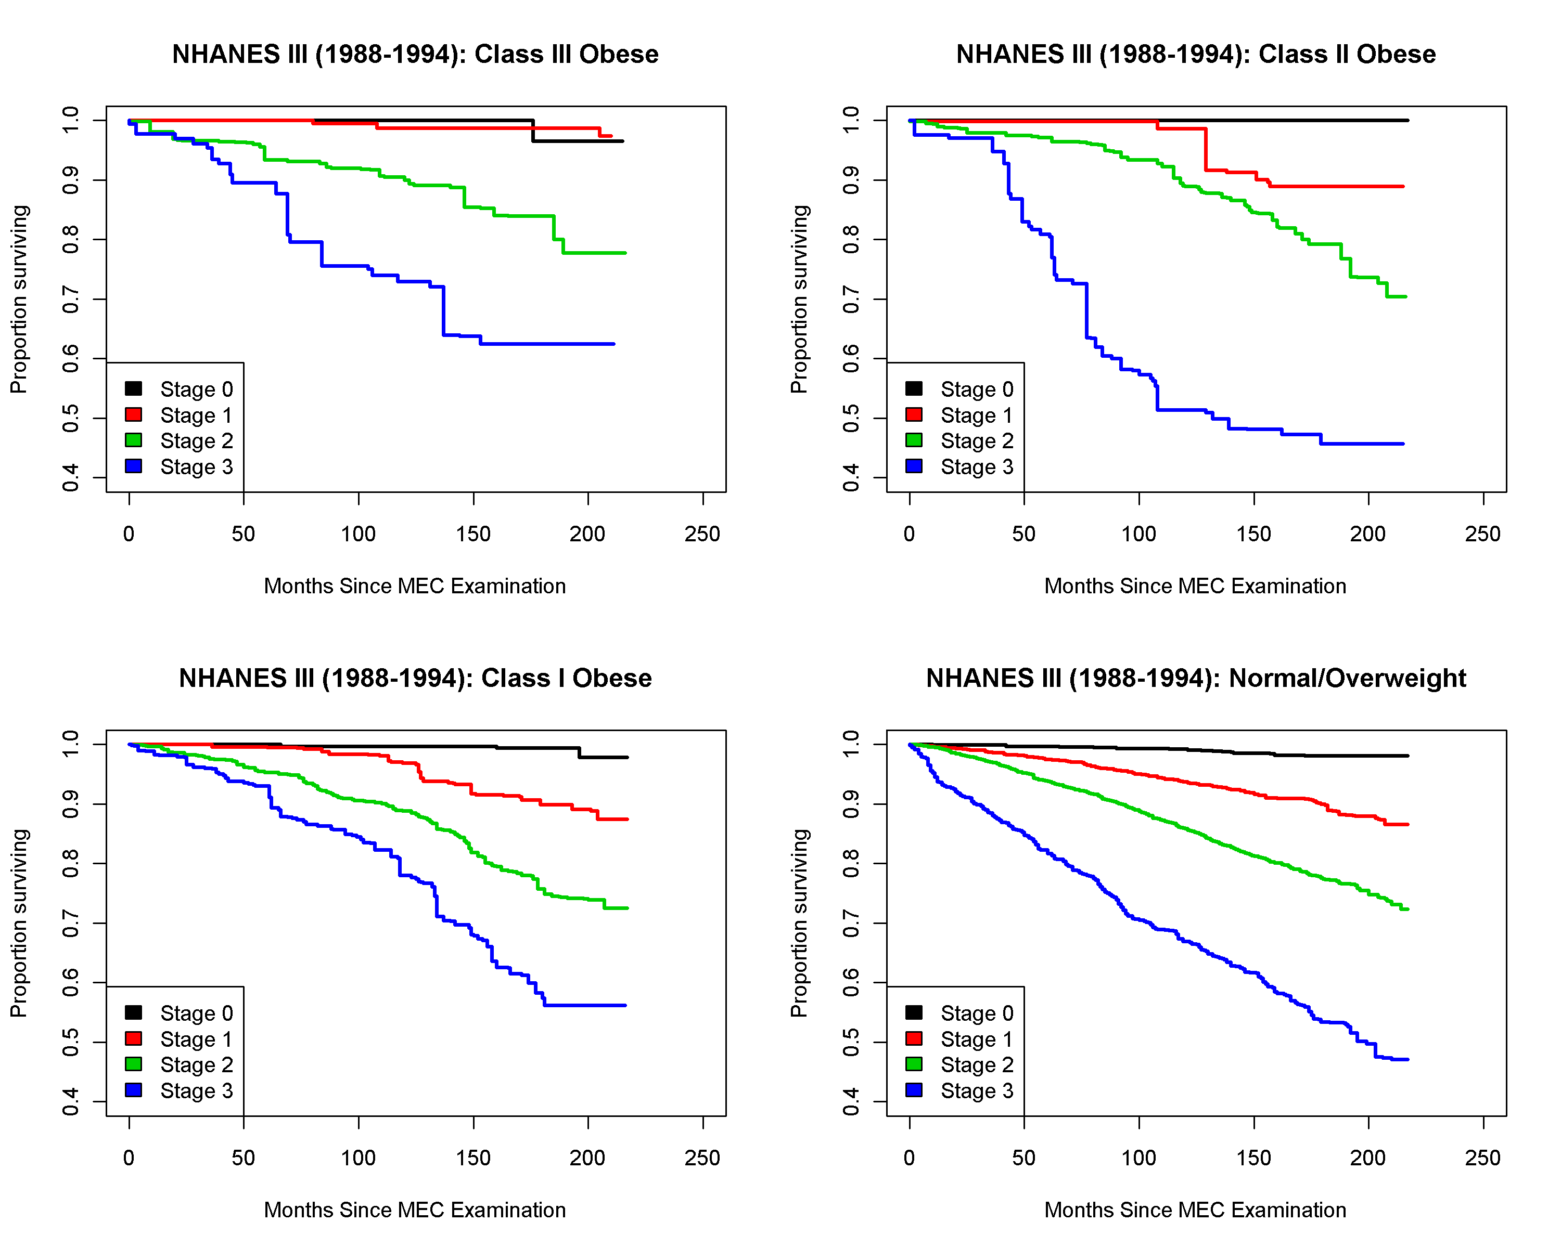
EOSS Predicts Mortality at Every Level of BMI NHANES III
Overweight
Padwal R, Sharma AM et al. CMAJ 2011

Slide 21
EOSS Distribution Across BMI Categories NHANES III (1988-1994)
Overweight
23 million
10 million
Class III
50 million
6 million
Padwal R, Sharma AM et al. CMAJ 2011

Slide 22
EOSS Case 1
24 year-old physically active female, BMI of 32 Kg/m² no demonstrable risk factors, no functional limitations, or mental health issues
Class I, Stage 0 Obesity
Focus on prevention of further weight gain
Health benefits of more aggressive obesity treatment likely marginal
Sharma AM & Kushner RF, Int J Obes 2009

Slide 23
EOSS Case 2
32 year-old male BMI of 36 Kg/m² hypertension, sleep apnea, depression
Class 2, Stage 2 Obesity
Clear benefits of obesity treatment
Sharma AM & Kushner RF, Int J Obes 2009

Slide 24
EOSS Case 3
63 year-old male BMI of 54 Kg/m² disabling osteoarthritis (wheel chair) severe hypoventilation, fibromyalgia, generalized anxiety disorder
Class 3, Stage 4 Obesity
Aggressive obesity treatment unless deemed palliative
Sharma AM & Kushner RF, Int J Obes 2009

Slide 26
Assess
BMI and Waist Circumference
Obesity Stage (EOSS)
Root causes of weight gain

Slide 27
Questions to Ask Yourself
Why is this person obese?
How is obesity affecting this patient?
What is the best treatment plan?

Slide 28
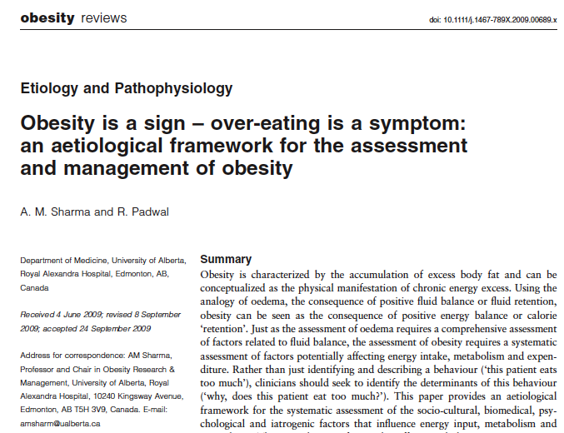
Sharma & Padwal, Obes Rev 2009

Slide 29
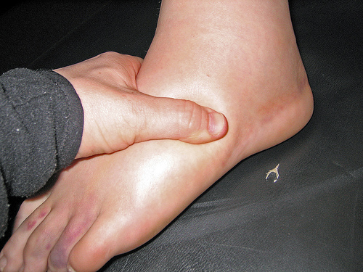
Edema = Positive Fluid Balance
Sharma & Padwal, Obes Rev 2009

Slide 30
X
?
X
Fluid In
Fluid Out
Sharma & Padwal, Obes Rev 2009

Slide 31
X
X
Energy In
Energy Out
Sharma & Padwal, Obes Rev 2009

Slide 32
Differential Approach to Obesity Assessment
Diet
Metabolism
Activity
100 %
60-80 %
40-20 %
Sharma & Padwal, Obes Rev 2009

Slide 33
Differential Approach to Obesity Assessment
Diet
Metabolism
Activity
Socio-Cultural
Age
Gender
Genetics
Hormones
Skeletal muscle
Medication
Socio-Cultural
Bio-Medical
Bio-Medical
Mental
Mental
Medication
Medication
Sharma & Padwal, Obes Rev 2009

Slide 34
Assess for Root Causes of Weight Gain
Is weight gain due to “slow” metabolism?
Is weight gain due to increased intake?
Is weight gain due to reduced activity?
Age? Sex?
Genetics?
Neuro-endocrine factors?
Prandial thermogenesis?
Brown fat?
Sarcopenia?
Post-weight loss?
Medications?
Sociocultural factors?
Knowledge deficit?
Saboteurs?
Mindless eating?
Physical hunger?
Emotional eating?
Psychiatric disorder?
Sleep deprivation?
Medications?
Sociocultural factors?
Physical limitations?
Chronic fatigue?
Musculo-skeletal Pain?
Cardio-respiratory?
Emotional barriers?
Psychiatric disorder?
Medications?
Address root cause of slow metabolism if feasible
Address root cause of increased intake if feasible
Address root cause of reduced activity if feasible
Sharma & Padwal, Obes Rev 2009

Slide 35
Assess
BMI and Waist Circumference
Obesity Stage (EOSS)
Root causes of weight gain
socioeconomic
emotional
medical

Slide 36
Advise on
Obesity risks

Slide 37
Advise on
Obesity risks
Benefits of modest weight loss

Slide 38
Advise on
Obesity risks
Benefits of modest weight loss
Need for long-term strategy

Slide 39
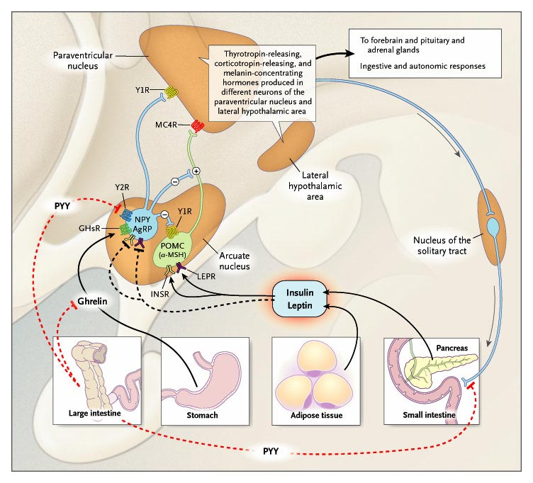
Isn’t Obesity Simple?
Genetics
Diet
Exercise
+/-
+/-
Energy
In
Energy
Out
Energy Regulation is Complex!
Sharma AM 2007

Slide 40
Phases of Obesity Treatment
Phase I
(Weight Loss)
Phase II
(Weight-Loss Maintenance)
When you stop treatment,
the disease comes back!
Weight
3-6 months
Indefinitely
www.drsharma.ca

Slide 41
Best Weight

Slide 42
Advise on
Obesity risks
Benefits of modest weight loss
Need for long-term strategy
Treatment options
Self-monitoring
Behaviour modification
Medications
Low calorie diets
Surgery

Slide 43
Agree on
Weight loss expectations

Slide 44
Treatment Success
Lifestyle (LS) ~ 3-5%
LS+Pharmacotherapy ~ 5-15%
Change in Weight
LS+Surgery ~ 20-30%
Years
www.drsharma.ca

Slide 45
Agree on
Weight loss expectations
Behavioural goals
Specific
Measureable
Attainable
Realistic
Timely

Slide 46
Agree on
Weight loss expectations
Behavioural goals
Specific
Measureable
Attainable
Realistic
Timely
Treatment plan

Slide 47
Assist
Identify drivers and barriers

Slide 48
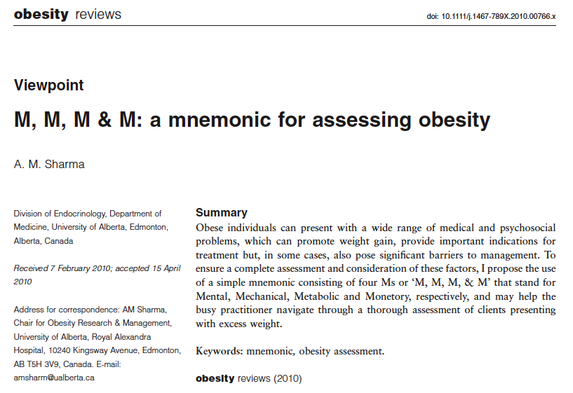

Slide 49
Obesity: Complications and Barriers (M, M, M & M)
Mental
Mood Disorder
Anxiety Disorder
Attention Deficit Disorder
Sleep Disorder
Personality Disorder
Addiction Disorder
Psychotic Disorder
Cognitive Disorder
Mechanical
Osteoarthritis
Pain
Reflux Disease
Obstructive Sleep Apnea
Urinary Incontinence
Intertrigo
Pseudotumor Cerebri
Plantar Fasciitis
Obesity
Monetory
Education
Employment
Low Income
Disability
Life/Health Insurance
Bariatric Furniture/Aids
Oversized Clothing
Weight Loss Programs
Metabolic
Type 2 Diabetes
Dyslipidemia
Hypertension
NAFLD
Gall Bladder Disease
PCOS
Infertility
Cancer
Sharma AM, Obes Rev 2010

Slide 50
Assist
Identify drivers and barriers
Provide resources

Slide 51
Assist
Identify drivers and barriers
Provide resources
Refer to program

Slide 52
Adult Bariatric Clinic, RAH, 2010

Slide 53
Assist
Identify drivers and barriers
Provide resources
Refer to program
Follow-up

Slide 54
The 5As of Obesity Management
Ask
Assist
Assess
Agree
Advise

Slide 55
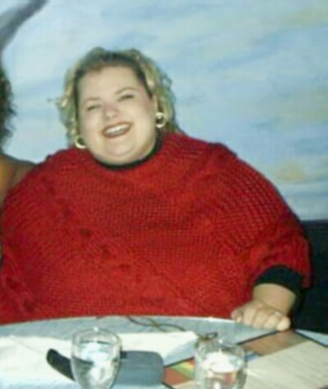
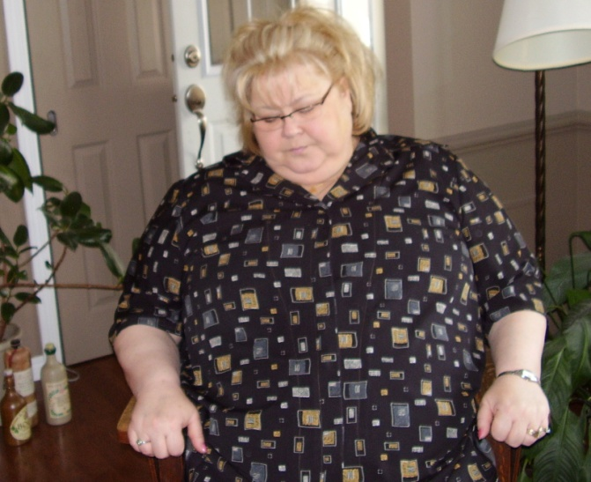
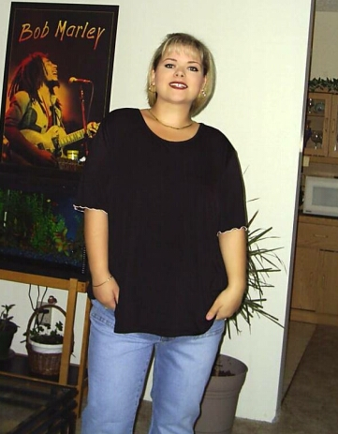
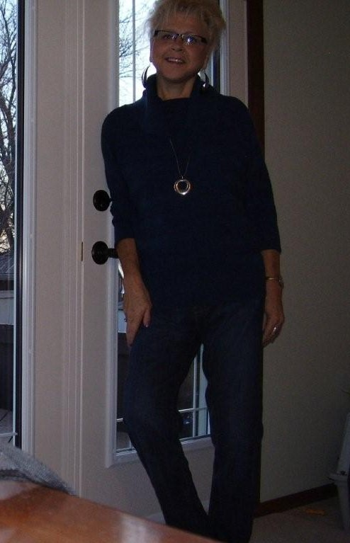
Weight Wise/CAMIS Success Stories

Slide 56
Assumptions Underlying the Weight-Focused Paradigm of Obesity Management
Adiposity poses significant mortality risk
Adiposity poses significant morbidity risk
Weight loss will prolong life
Anyone who is determined can lose weight and keep it off through appropriate diet and exercise
The pursuit of weight loss is a practical and positive goal
The only way for overweight and obese people to improve health is to lose weight
Obesity-related costs place a large burden on the economy, and this can be corrected by focused attention to obesity treatment and prevention
Adapted from Bacon & Aphromar, Nutrition J, 2011

Slide 57
Summary
Obesity is a complex and heterogeneous disorder
BMI is a poor measure of obesity related health risks
The Edmonton Obesity Staging System may provide a clinically more rational approach to assessing and managing obesity
Obesity management should be based on an etiological assessment of weight gain
Success of obesity management programs should not be measured in pounds lost

Slide 58
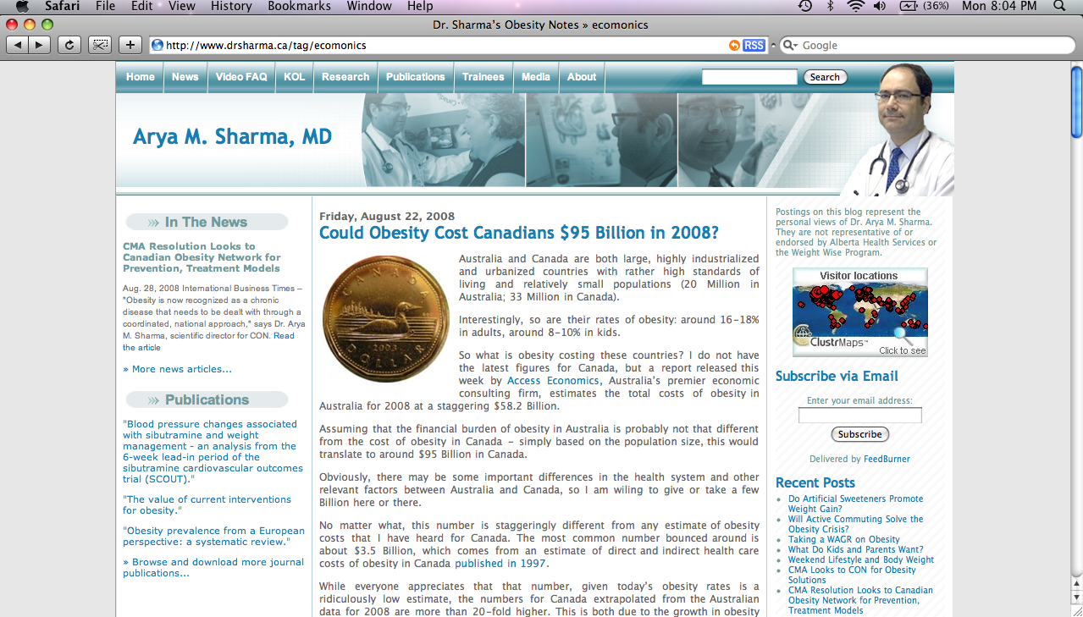
My Obesity Blog: www.drsharma.ca

