Slide 1
The Edmonton Obesity Staging System (EOSS)
Arya M Sharma, MD, FRCP(C)
Professor of Medicine
Research Chair for Obesity Research & Management
University of Alberta Medical Director Alberta Obesity Prevention & Bariatric Care Strategy
Edmonton, AB, Canada
www.drsharma.ca

Slide 2
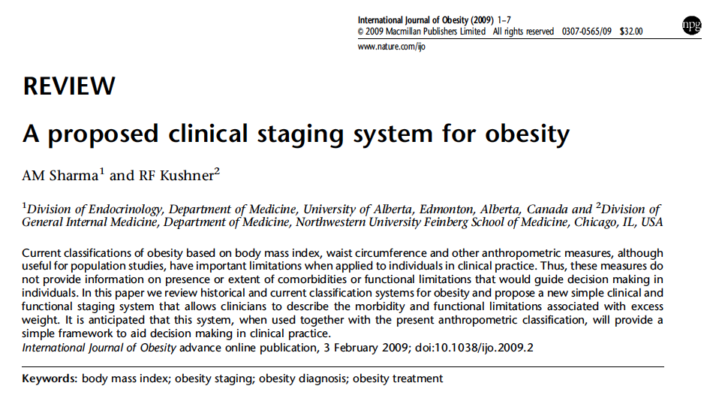

Slide 3
Edmonton Obesity Staging System (EOSS)
Stage 2
co-morbidity
Stage 1
moderate
Stage 3
pre-clinical risk factors
end-organ damage
moderate
mild
severe
mild
severe
Stage 0
Obesity
Stage 4
absent
absent
end-stage
absent
end-stage
end-stage
Medical
Mental
Functional
Sharma AM & Kushner RF, Int J Obes 2009

Slide 4
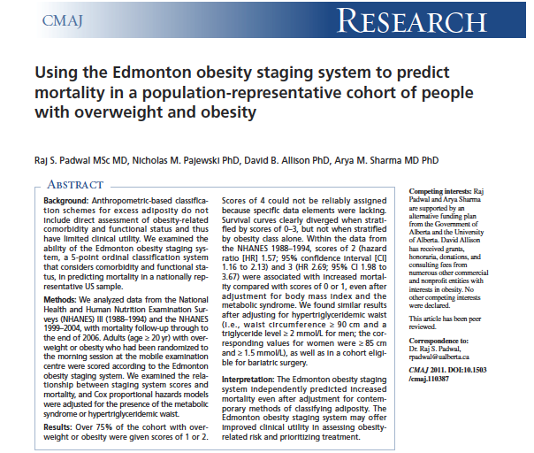

Slide 5
EOSS Predicts Mortality in NHANES III
Padwal R, Sharma AM et al. CMAJ 2011

Slide 6
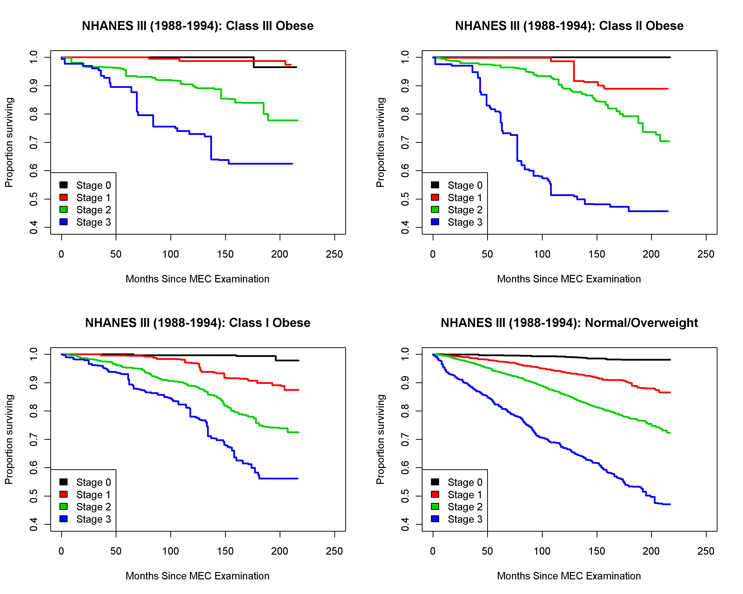
EOSS Predicts Mortality at Every Level of BMI NHANES III
Overweight
Padwal R, Sharma AM et al. CMAJ 2011

Slide 7
EOSS Distribution Across BMI Categories NHANES III (1988-1994)
Overweight
23 million
10 million
Class III
50 million
6 million
Padwal R, Sharma AM et al. CMAJ 2011

Slide 8
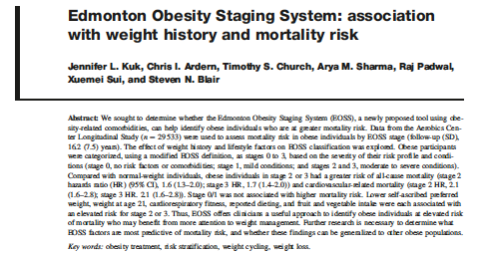

Slide 9
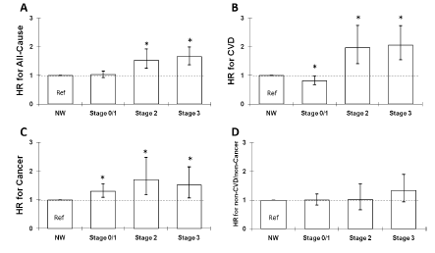
Association Between EOSS and Mortality Risk in Aerobics Center Longitudinal Study (n = 29 533)
Kuk JL, et al. Appl. Physiol. Nutr. Metab. 2011;36: 570

Slide 10
EOSS Case 1
24 year-old physically active female, BMI of 32 Kg/m² no demonstrable risk factors, no functional limitations, or mental health issues
Class I, Stage 0 Obesity
Focus on prevention of further weight gain
Health benefits of more aggressive obesity treatment likely marginal
Sharma AM & Kushner RF, Int J Obes 2009

Slide 11
EOSS Case 2
32 year-old male BMI of 36 Kg/m² hypertension, sleep apnea, depression
Class 2, Stage 2 Obesity
Clear benefits of obesity treatment
Sharma AM & Kushner RF, Int J Obes 2009

Slide 12
EOSS Case 3
63 year-old male BMI of 54 Kg/m² disabling osteoarthritis (wheel chair) severe hypoventilation, fibromyalgia, generalized anxiety disorder
Class 3, Stage 4 Obesity
Aggressive obesity treatment unless deemed palliative
Sharma AM & Kushner RF, Int J Obes 2009

